Slide 1
From Palo Alto website
As customers look to move their applications and data to the public cloud, it is not uncommon to hear questions around traditional data center constructs such as high availability (HA) arise.
The question is often times posed as “how do you support HA in AWS or Azure.”
A more cloud-centric way to pose the question would be “do we need HA in the public cloud?”
If the question is, do we need a fully redundant, highly available solution for securing public cloud applications? Then the answer is definitely yes.
But if the question is, do we need PAN-OS stateful HA failover just like we did in the private cloud, then the answer is probably not.
The VM-Series does support HA for AWS but it generally isn't needed if the customer uses the public cloud migration as an opportunity to update their applications to take advantage of native cloud services to build a resilient architecture that maximizes uptime. Many customers will begin their migration to the public cloud adhering to a traditional data center hardware requirements list (redundant switches, routers, firewalls, etc) which may limit the ability to leverage the power of the cloud. I know this isn't always possible but the try to leave that baggage behind.
https://knowledgebase.paloaltonetworks.com/KCSArticleDetail?id=kA10g000000ClD9CAK
Notes:
https://knowledgebase.paloaltonetworks.com/KCSArticleDetail?id=kA10g000000ClD9CAK

Slide 2

Networking in AWS
This presentation tries to explain AWS networking concepts and differences between traditional Datacentre and Public Cloud networks.

Slide 3
Definitions
Instance - Virtual machine (VM)
Availability Zone (AZ) - set of buildings, Internet uplinks, and power. You can think of it as a data centre, but some Availability Zones contain more than one physical data centre.
Region - collection of Availability Zones. You can think of a Region as containing multiple data centres within the same geographic area (US East, Australia, EU West, etc.).
Elastic Network Interface (ENI) – “floating” interface that can be assigned programmaticaly to an Instance (VM)

Slide 4
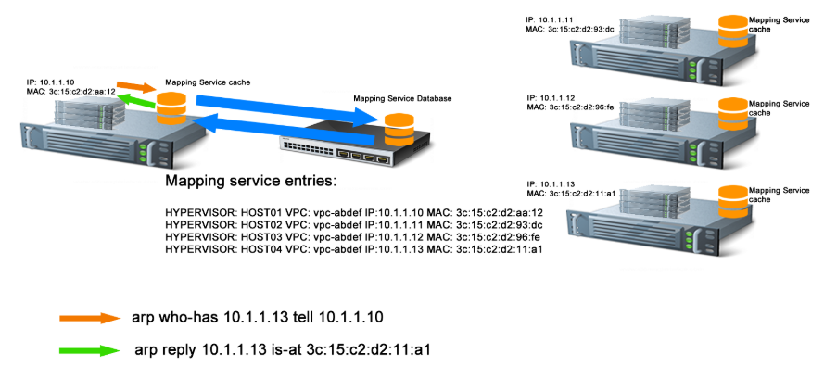
Under the hood - AWS SDN Mapping Service
Similar concepts as in VMWare NSX
Details are not revealed by AWS
The mapping service registers every EC2 instance started by a customer
When an EC2 instance sends an ARP request to reach any other instance, instead of allowing this broadcast on the network, the hypervisor catches the request, sends it to the mapping service data base, which will reply with the requested MAC address but also with the IP of the hypervisor IP of the host on which the target instance is running.
Notes:
Source: http://txens.io/index.php/2016/12/16/a-deep-dive-into-the-aws-network/

Slide 5
No OSI Layer 1 and 2
AWS does not support Layer 2 protocol forwarding
All frames are intercepted by the hypervisor
Consequences:
No broadcast domains
No ARP and GARP
No HSRP, VRRP
No CDP, LDP
No LAG (LACP)
Multicast is not supported
No routing protocols relying on multicast neighbours discovery – OSPF, EIGRP, RIPv2
Only BGP is supported
Build overlay networks if you need the features above.

Slide 6
Networking building blocks: VPCs Subnets Routing tables Internet and NAT Gateways Elastic Network Interfaces VPC Endpoints

Slide 7
Networking Building Blocks Amazon Virtual Private Cloud (VPC)
Essential building block - similar to virtual routing and forwarding (VRF)
Your network goes here

Slide 8
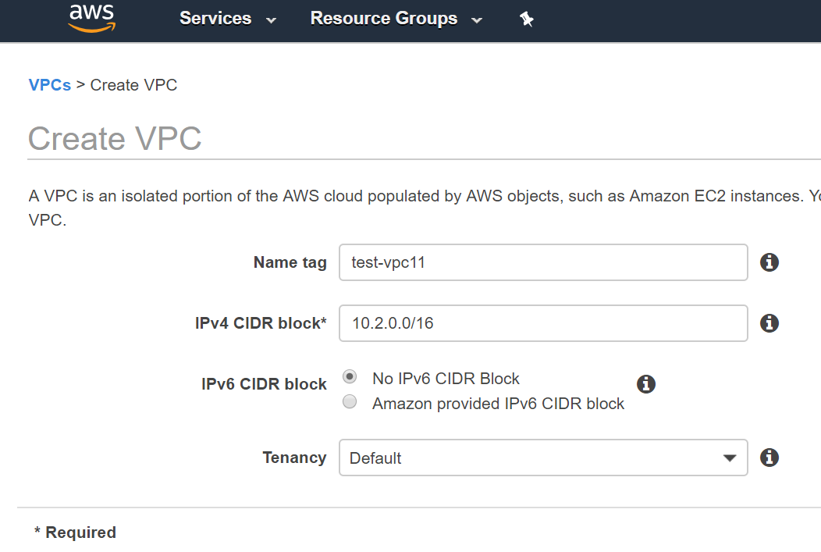
CIDR size from /16 to /28 which then split to subnets No Layer 2, no broadcast domains, per-interface security rules, so it’s OK (and even recommended) to allocated large CIDRs for VPCs and server subnets such as /18. IPv4 subnets can be any, even non-RFC1918 (but they will stay private to your VPC and why? ☺) Note that IPv6 address ranges are allocated by Amazon as /56 blocks from their own ranges.

Slide 9
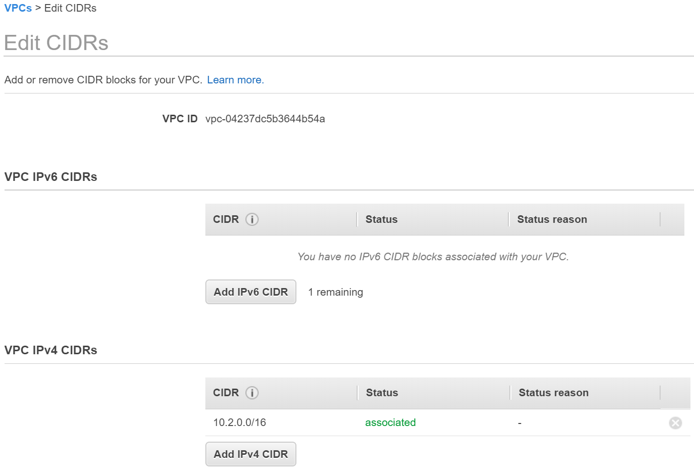
It is possible to add new CIDR ranges, but the address range defined at VPC creation can’t be deleted. Address planning is important as VPCs can have overlapping addresses, but these VPCs can’t be peered. If IPv6 addresses allocated, they are assigned to instances in addition to IPv4, so the number of available IPv4 addresses will limit the number of IPv6 hosts

Slide 10
Networking Building Blocks Subnets
Next step - Create your subnets
…
VPC Subnet 1
VPC Subnet 2
VPC Subnet ‘n’

Slide 11
Subnets
Subnets take a variable portion of the CIDR block assigned to the VPC.
Subnet can’t span multiple AZ
AWS reserves five addresses in each subnet―the first four and the last address, for example for 10.1.1.0/24:
10.1.1.0: Network address.
10.1.1.1: VPC router (implicit router)
10.1.1.2: DNS server
10.1.1.3: Reserved by AWS for future use.
10.1.1.255: Network broadcast address. Even though AWS does not support broadcast in a VPC, this address is reserved.

Slide 12
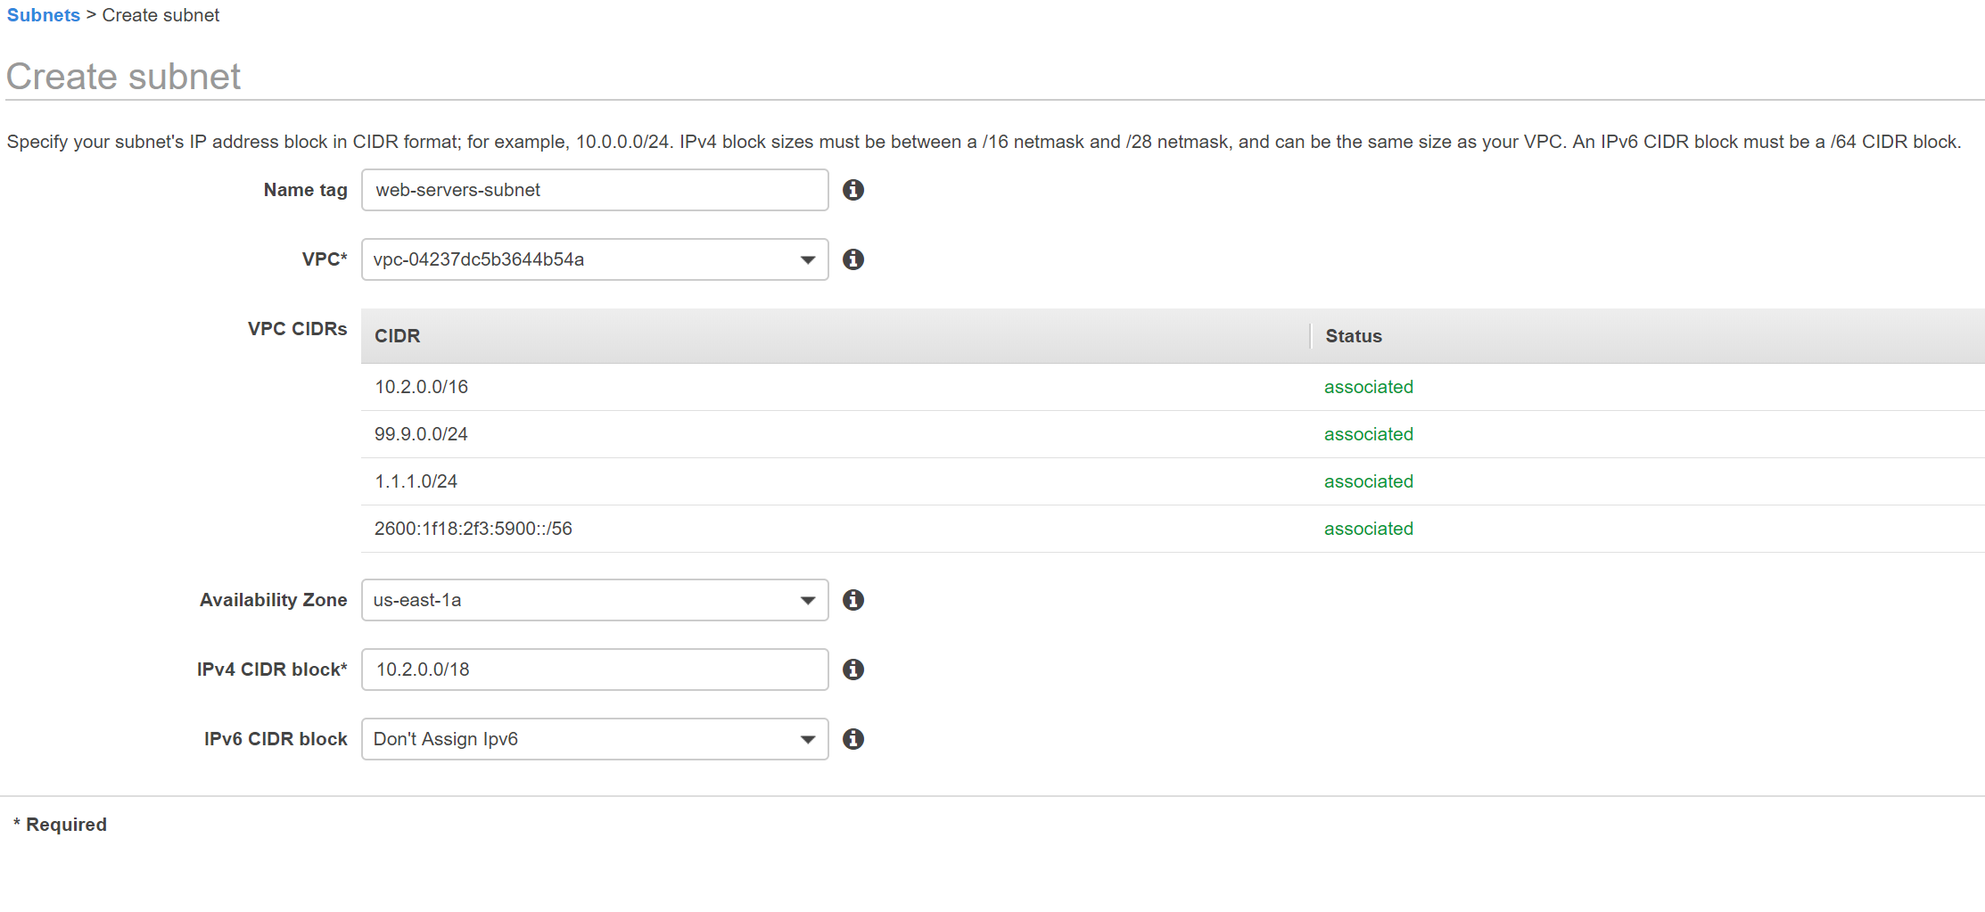

Slide 13
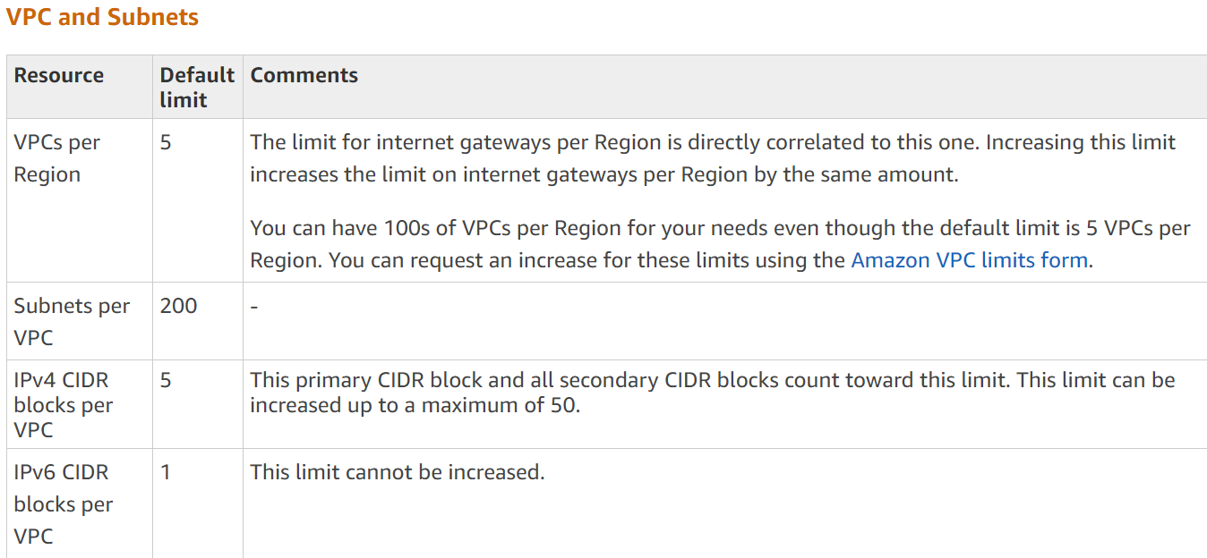
Watch these (and other) limits

Slide 14
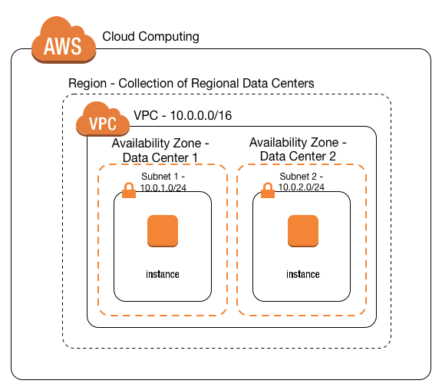
VPC and Subnets - Summary

Slide 15
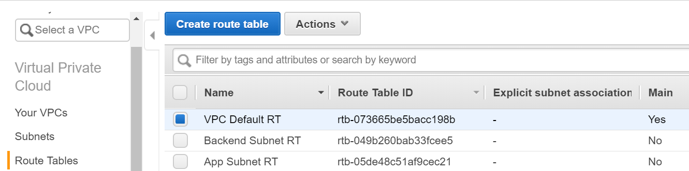
Networking Building Blocks Routing Tables
Every subnet has a route table, and a single route table can be associated with multiple subnets.
Route tables act like a source-based policy-based routing (PBR) rule. In other words, you can choose which direction packets should go based on the subnet the instance is in.
Create a routing table and then associate to a subnet
If no routing table is associated to a subnet, then per-VPC default RT is used (Main)

Slide 16
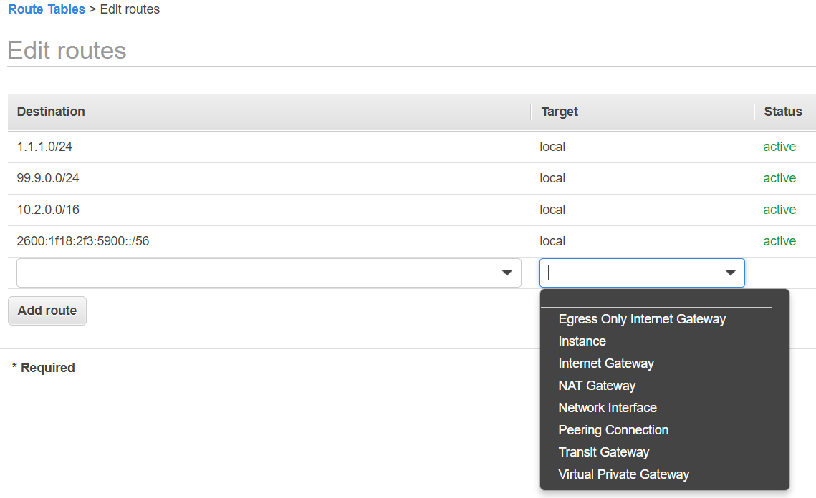
Add route Like in a traditional network - specify network in CIDR format and target CIDR ranges for VPC can’t be changed, with target Local – this is Implicit AWS VPC router
Instance - Virtual machine (VM) – Firewall or NAT Instance, as an example
Network interface - ”floating” NIC, can be assigned to a running instance, so think failover between two active/passive instances, also for VPC endpoints
Internet Gateway – AWS-managed construct providing access to Internet from a Public subnet (explained later)
NAT Gateway – AWS-managed construct providing access to Internet from a Private subnet
Egress Only GW – access from private network for IPv6 (as no NAT in IPv6)
Peering connection/Transit Gateway – for VPC interconnects
Virtual Private Gateway – for On-Prem interconnects, or for VPC interconnects in some cases

Slide 17
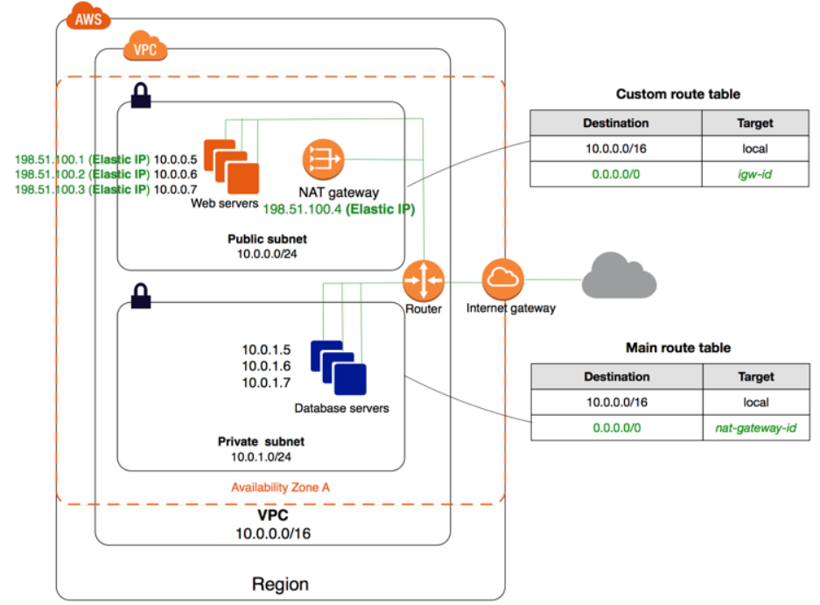
Networking Building Blocks Internet and NAT Gateways
You may see references to public and private subnets. There is no difference between them except the presence of Internet GW. IP Addresses assigned to Instances interfaces are always private.
Public subnet has Internet GW
which is AWS logical construct providing access to Internet. AWS builds one-to-one NAT to associate Instance interface IP to Public IP addresses (aka Elastic IPs)
Private subnets have no Internet GW, so there is no 1-1 NAT and direct access to/from Internet. Instances have to use NAT gateway (AWS Managed) or any Instance providing NAT or proxy services (firewall running as a VM, for example).
Note these NAT instances should have EIP, so be in located a Public subnet.
Note: NAT Gateway is billed per hour and not included in free tier.

Slide 18
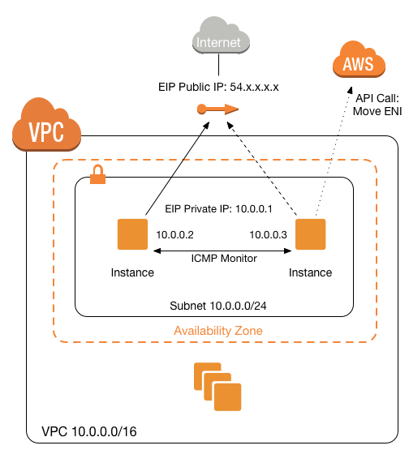
Networking Building Blocks Elastic Network Interfaces
Elastic network interface (ENI) that moves between two or more instances is similar to VIP. This is also called a floating ENI.
Elastic network interfaces can be used to provide failover between FW instances.
From Palo Alto documentation:
When the passive peer detects this failure it becomes active and triggers API calls to the AWS infrastructure to move all the dataplane interfaces (ENIs) from the failed peer to itself.
Cloudwatch can also trigger Lambda functions to move ENIs between instances.
Also consider alternative designs (such as Load balancers)

Slide 19
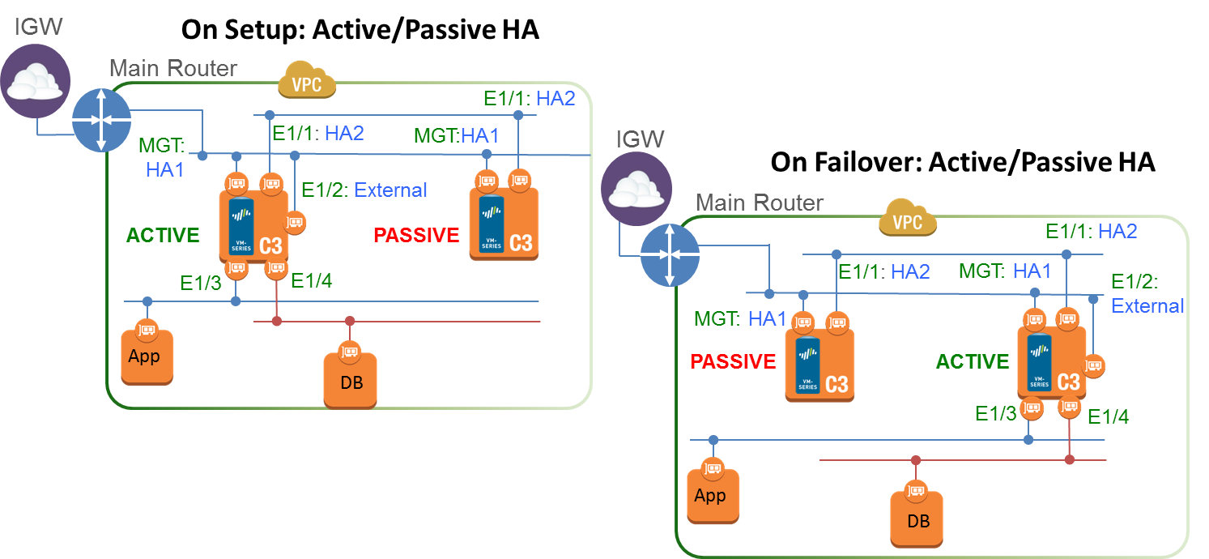
Palo VM series failover
https://docs.paloaltonetworks.com/vm-series/9-0/vm-series-deployment/set-up-the-vm-series-firewall-on-aws/high-availability-for-vm-series-firewall-on-aws/overview-of-ha-on-aws.html

Slide 20
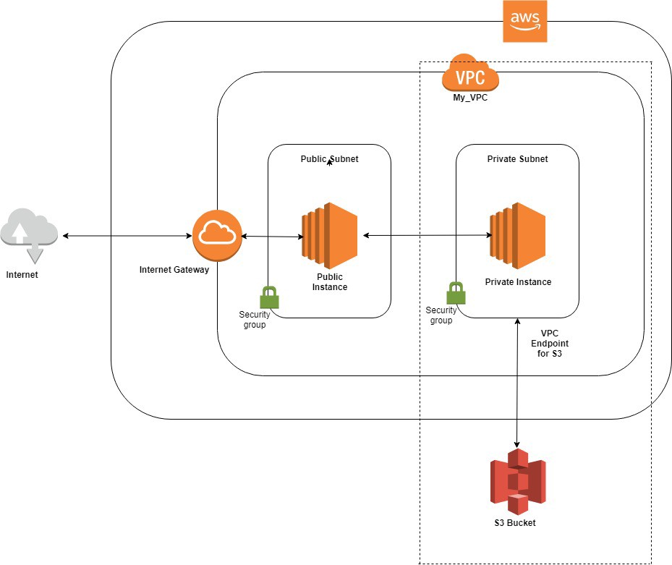
Networking Building Blocks VPC Endpoints
All AWS SaaS and PaaS services have public IP addressing, so your instances, even located in Private subnets should have Internet access to consume them.
From security perspective it is not always allowed.
Solution – VPC endpoints
Direct connectivity to AWS without requiring an internet gateway, NAT device, etc.
Kind of “shortcut” to AWS from VPC. Traffic between VPC and the other service does not leave the Amazon network, so it is more like a private “datacentre”.
Two types of VPC endpoints – Gateway and Interface, depending on AWS service.

Slide 21
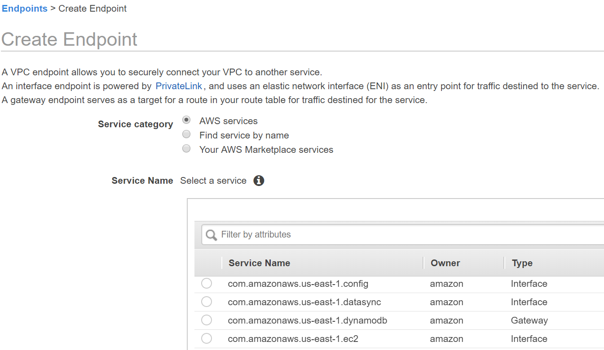

Slide 22
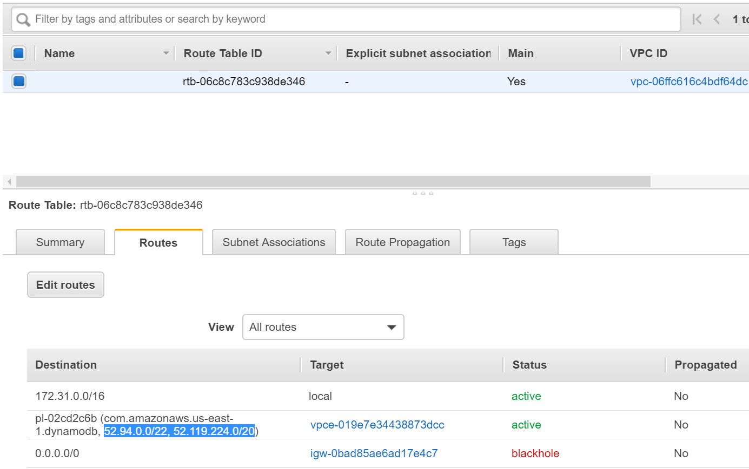
Gateway VPC endpoint
Gateway is a route to a virtual AWS “gateway”
Destination is a prefix list automatically populated by AWS with network ranges specific to the service.
Note blackhole route to igw-xxxx. Route pointing to deleted Internet GW

Slide 23
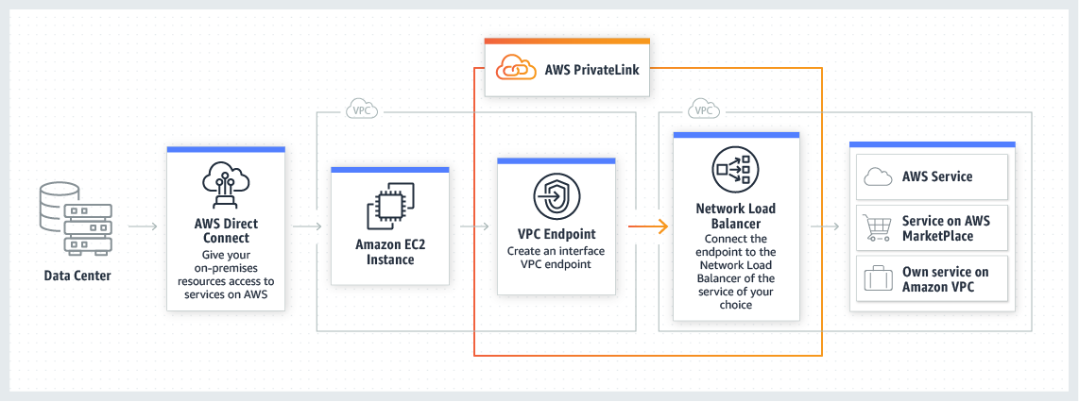
Interface VPC Endpoint (also referred as PrivateLink endpoint)
Interface VPC Endpoint looks like a Network interface from other VPC, enabling direct connectivity to the service via private IP addresses. PrivateLink provides private SaaS between VPCs.
Uses concepts as Client VPC and Provider VPC.
Network Load Balancer’s interface from Provider VPC is exposed to Consumer VPC.
Notes:
https://aws.amazon.com/privatelink/
PrivateLink creates for providing highly secure, private SaaS between VPCs.
https://docs.netapp.com/us-en/occm/task_backup_to_s3.html
https://www.dynatrace.com/news/blog/improve-security-connectivity-privatelink-dynatrace/

Slide 24
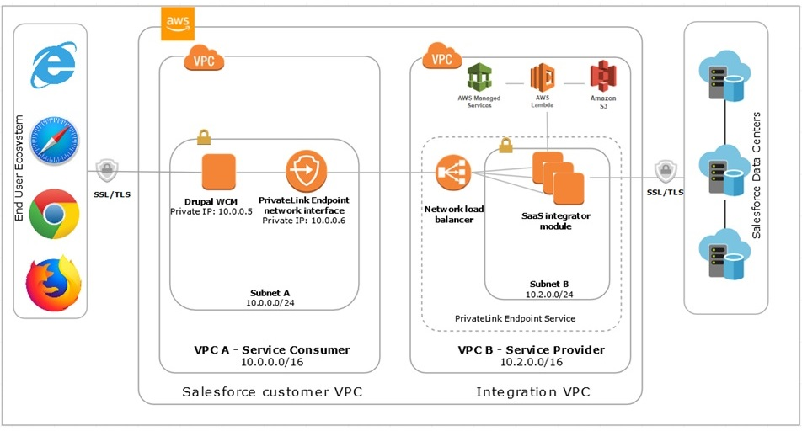
Example – connecting to Salesforce via PrivateLink
Notes:
https://aws.amazon.com/blogs/apn/connecting-aws-and-salesforce-enables-enterprises-to-do-more-with-customer-data/

Slide 25
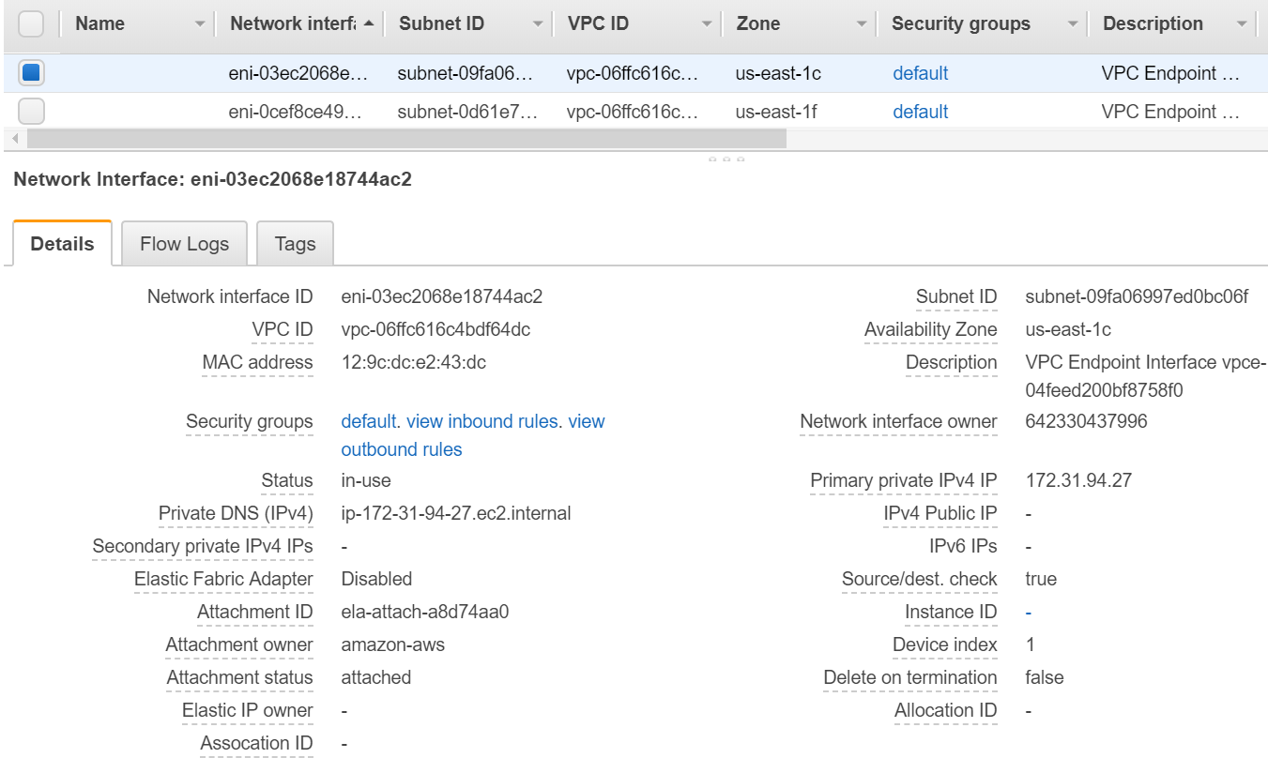
After creating VPC Interface endpoint it appears as a Network interface directly in your subnet with subnet’s IP address:

Slide 26
Network control: Security Groups Network Access Lists

Slide 27
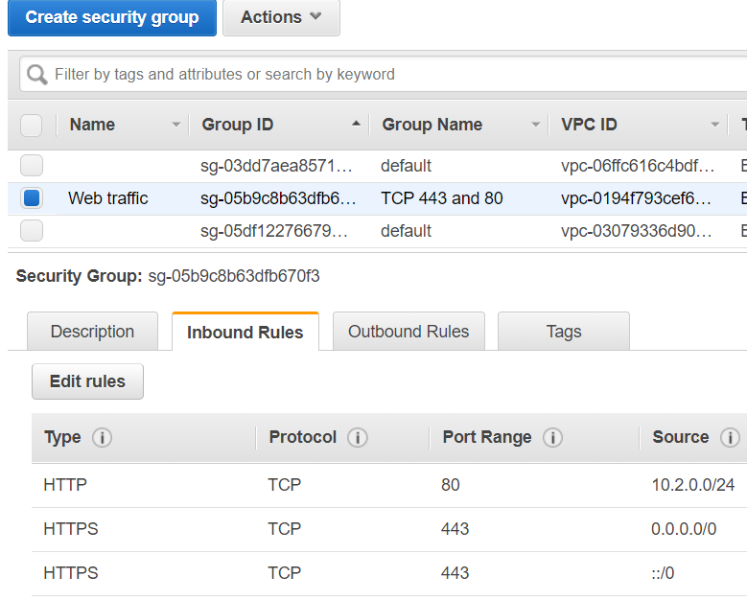
Network Control Security Groups
Per-Instance Hypervisor-level firewall
Enforced at the Instance level or Interface (if multiple interfaces)
Stateful – if traffic is allowed by inbound rules, outbound traffic automatically allowed
Only ALLOW rules, no DENY, all traffic is denied unless explicitly allowed
Possible to use Security Group names as source
No order – just ALLOW statements
Notes:
Security groups are instance based (instance ENI to be accurate)
Security groups are stateful (outbound responses to inbound rules are allowed regardless of other outbound rules)
Allow only (whitelist)
Evaluative (rules are evaluated as a whole)

Slide 28
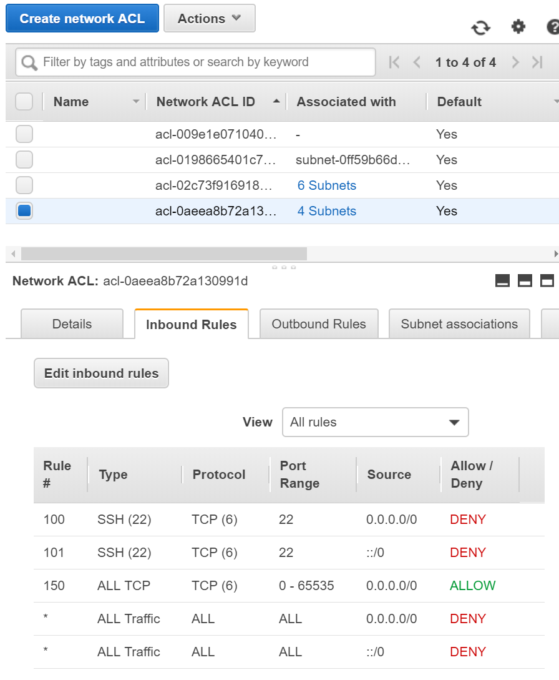
Network Control Network Access Lists
Per-subnet
Stateless - Return traffic must be explicitly allowed by rules
Process rules in number order when deciding whether to allow traffic
Very similar to traditional routers’ ACLs
Can be pretty complex to manage if used together with security Groups

Slide 29
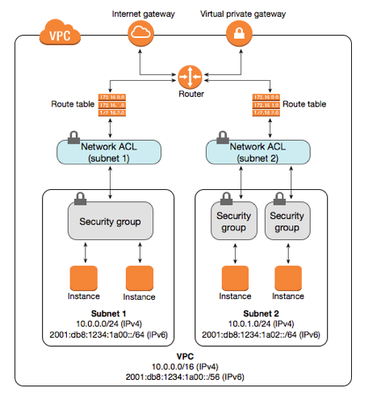
Network Control - Summary

Slide 30
Interconnects between AWS and On-prem networks

Slide 31
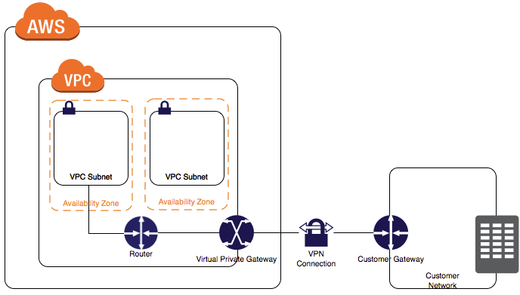
VPN Gateway
Logical construct, create and attach to VPC

Slide 32
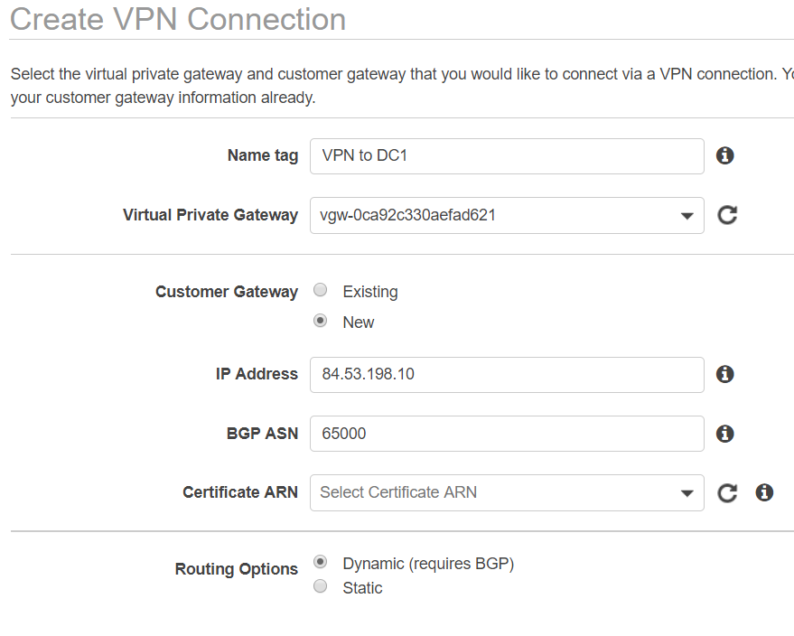
Receives routes over BGP – propagated automatically into VPC Routing table
Advertises VPC’s CIDR subnets via BGP
Alternatively create static routes in VPC pointing to VPN GW
Supports PSK or CA-based authentication
Builds two tunnels to Customer GW, active/failover, but can be used act/act with BGP
1.25 GBps limit per tunnel
Notes:
https://aws.amazon.com/premiumsupport/knowledge-center/vpn-fault-tolerance/

Slide 33
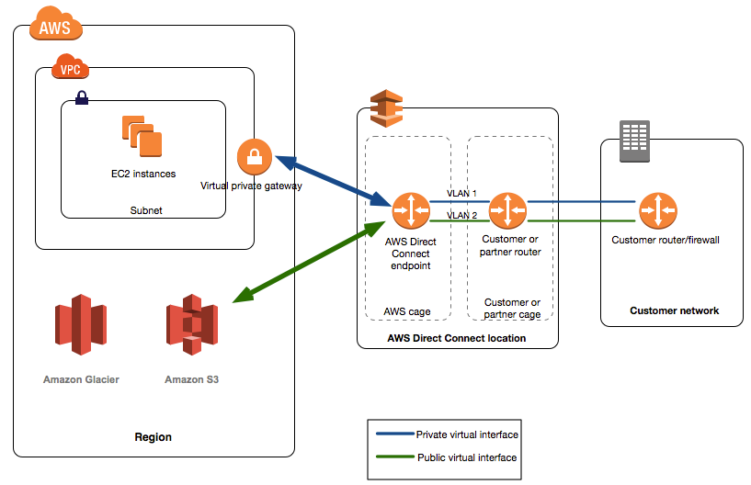
Alternative to VPN – Direct Connect
Dedicated links to AWS
Direct 1/10Gig optic link if in the same Datacentre
Or via SP such as Megaport, Telstra, Vodafone, etc.
In any case it is a VLAN and L3 point-to-point interface
Uses BGP
Use at least two DX, and you can leverage BGP standard traffic engineering techniques – AS-Path prepend, communities, etc.
Traffic is not encrypted. Use IPSec VPN over Direct connect if there is such a requirement

Slide 34
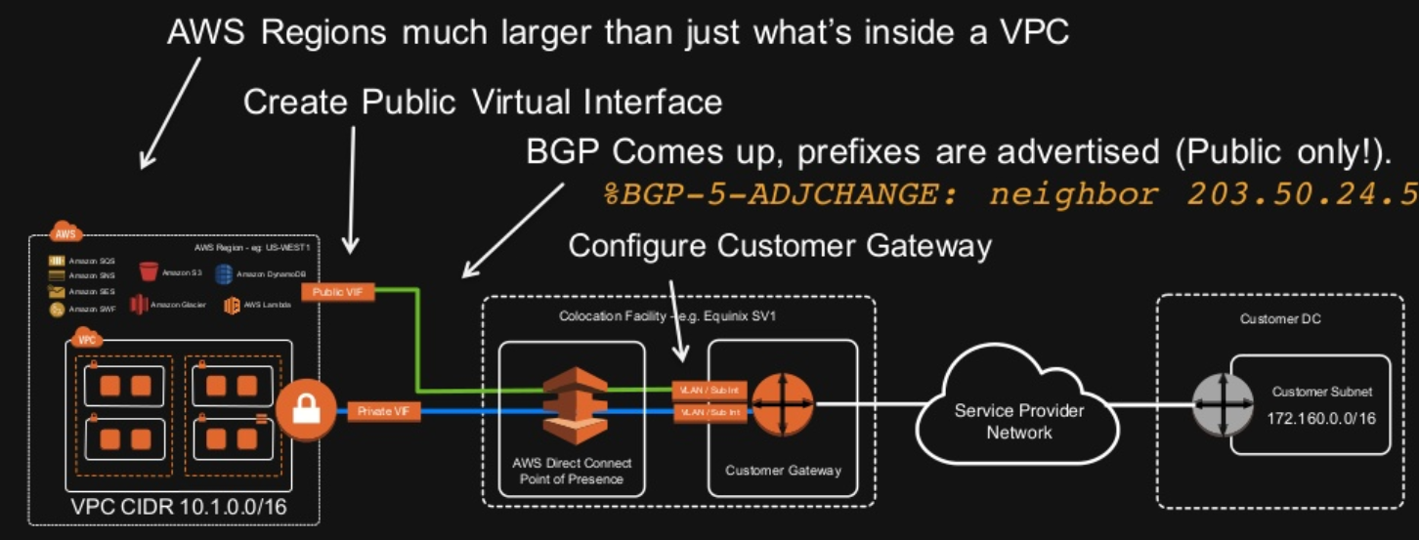
Two types of Direct Connect Interfaces – Public or Private

Slide 35
Interconnects between VPCs

Slide 36
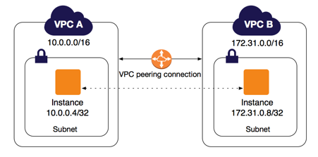
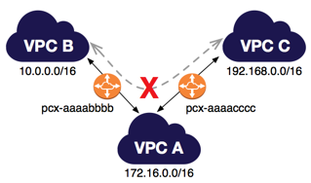
Interconnect VPC - VPC Peering
Add peering connection to another VPC
Add route to routing table pointing to VPC peering link
Transitive peering is not supported, so VPC B can’t access VPC C via VPC A.
Solution – Full-mesh peering or Transit Gateway

Slide 37
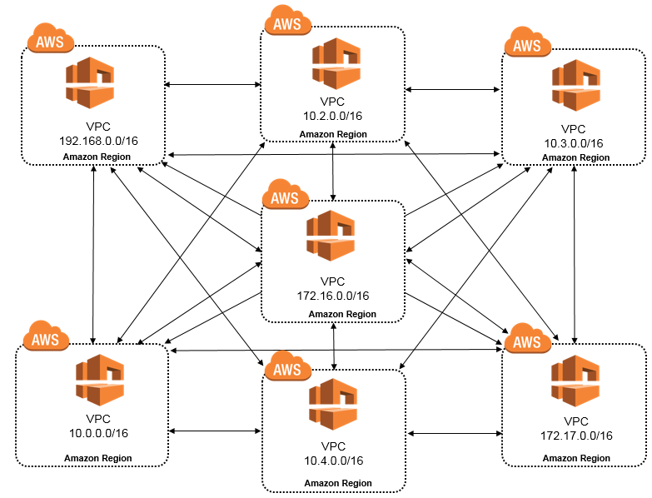
Full-mesh peering
Max 50 peering connections per VPC. Not scalable, but the cheapest option

Slide 38
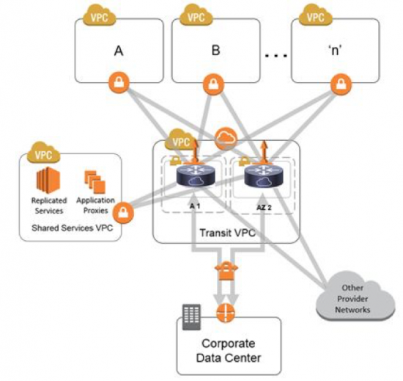
VPN GWs is not only for On-prem connectivity – Transit VPC
Remember non-transitive routing rule?
Transit VPC is no overcome this and avoid building full-mesh VPC
Two Instances are built running Cisco CSR 1000v, Fortigate, Palo, anything which supports IPSec tunnels
Assign public IP addresses to these Instances
Build IPSEC VPN with spoke VGWs
Establish BGP via IPSEC VPN tunnel
Use AS-path prepend in BGP for one of the firewalls, so all spokes use the same firewall based on BGP
Expensive, complex, and pretty common, but not relevant anymore after AWS introduced Transit GW

Slide 39
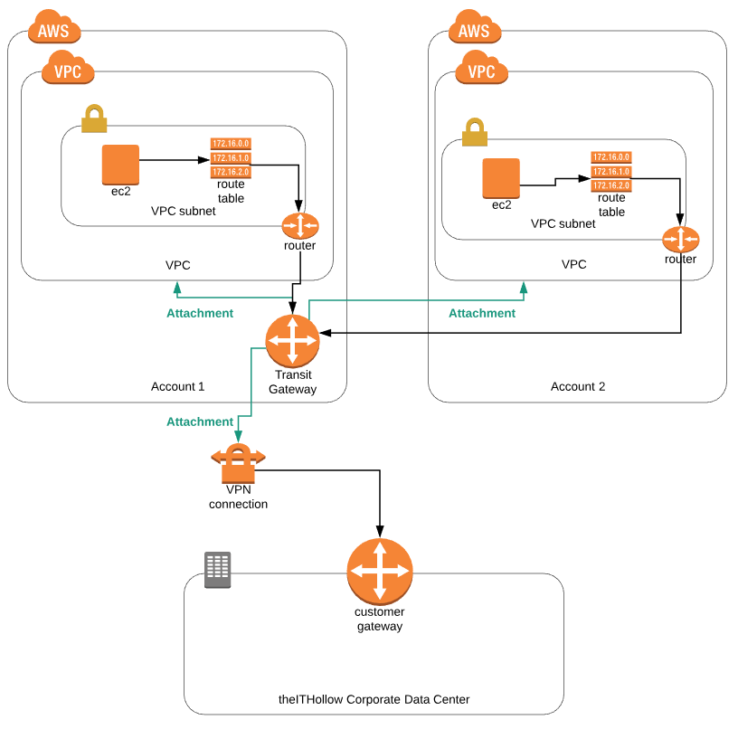
Transit Gateway
Transit GW is similar to a multi-VRF router which imports/exports routes between VRFs (VPCs in our case) creating Route Domains
TGW concepts:
TGW Route tables (don’t confuse with VPC routing tables) – routing domains with routes imported from VPCs or built manually
Attachment (routes to import FROM) and propagation (routes imported TO) – Can be VPC, VGW, Direct Connect
Allows to built complex scenarios, restrict East-West traffic, force traffic to Security VPCs, etc
Not free – Price per GB of data processed and per attachment/hour
Notes:
https://www.slideshare.net/AmazonWebServices/

Slide 40
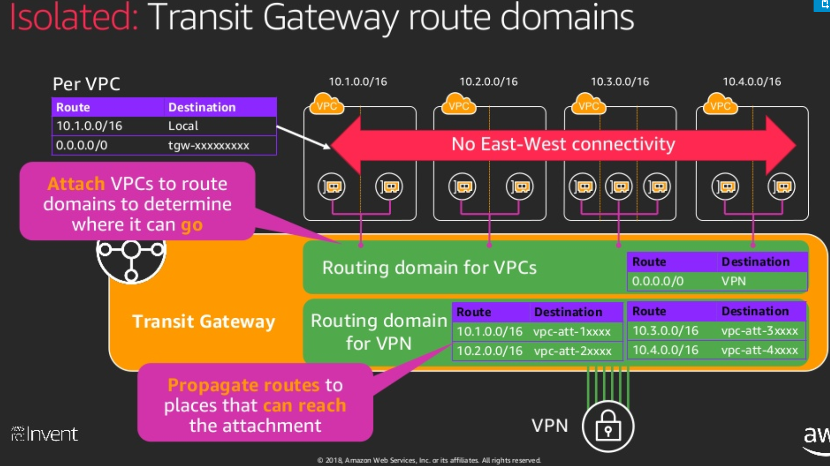
TGW Allows to implement complex designs
Notes:
new-launch-aws-transit-gateway-and-transit-vpcs-reference-architectures-for-many-vpcs-net402-aws-reinvent-2018

Slide 41
AWS Managed Network Services Load Balancers WAF

Slide 42
AWS Managed Network Services Load balancers
Two types of managed Load-balancers:
Network LB
Application LB
Classic LB still exists, but considered as Legacy

Slide 43
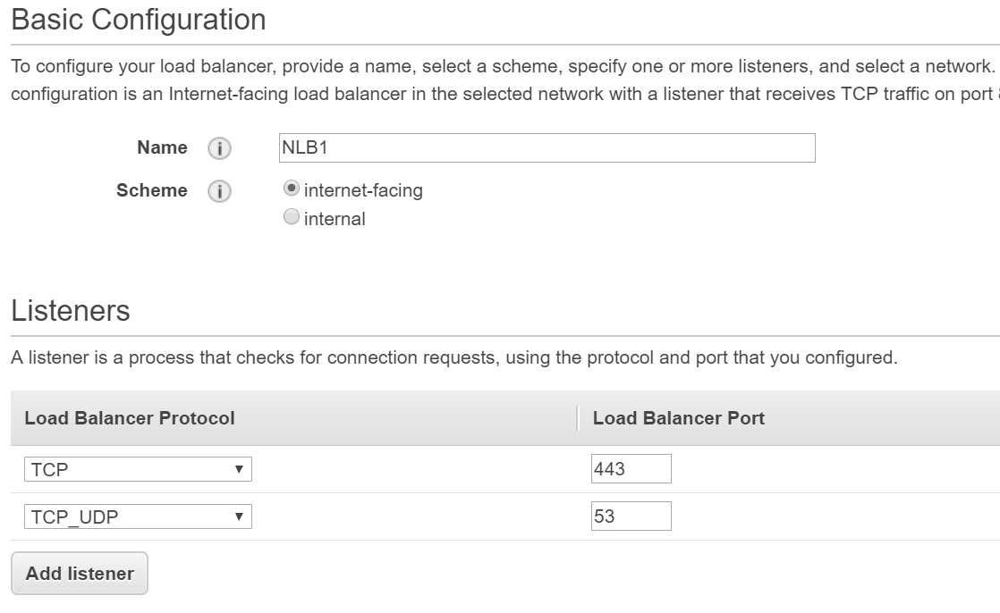
Network Load Balancers are used to route traffic at Layer 4
High-throughput, millions request per seconds
TCP or UDP
Integrates with EC2 Auto Scaling Elastic to enable you to attach one or more load balancers to an existing Auto Scaling group. After you attach the load balancer, it automatically registers the instances in the group and distributes incoming traffic across the instances.
Add Listeners and then Target Groups
AWS Managed Network Services Network Load Balancer
Notes:
https://aws.amazon.com/blogs/aws/new-tls-termination-for-network-load-balancers/
https://aws.amazon.com/blogs/aws/new-network-load-balancer-effortless-scaling-to-millions-of-requests-per-second/

Slide 44
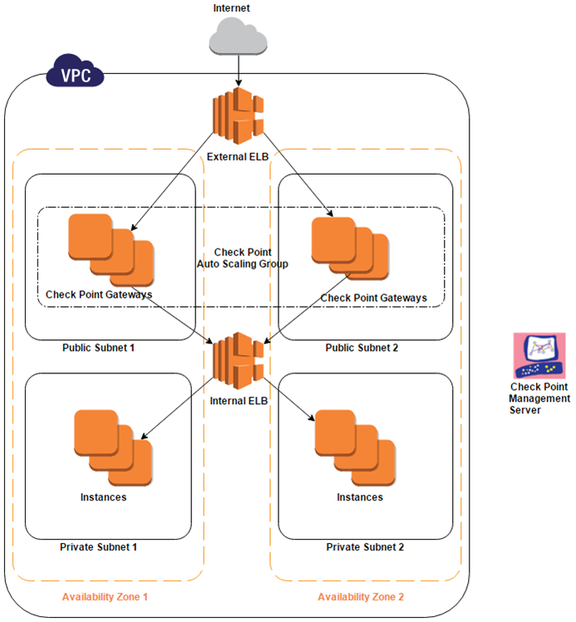
Common design – NLB Sandwich for ingress traffic
VPC spans 2 availability zones
Each availability zone has a public subnet and a private subnet.
An External ELB sends incoming traffic to a Firewall Auto Scaling Group residing on the two public subnets.
The FWs in the group inspect the traffic and forward the traffic to an Internal ELB.
The Internal ELB sends incoming traffic to a group of servers residing on the two private subnets.
The FW Auto Scaling Group is set up to increase or decrease the number of FWs based on AWS Cloud Watch metrics like other instances.
Notes:
https://github.com/PaloAltoNetworks/aws-alb-sandwich
https://supportcenter.checkpoint.com/supportcenter/portal?eventSubmit_doGoviewsolutiondetails=&solutionid=sk112575

Slide 45
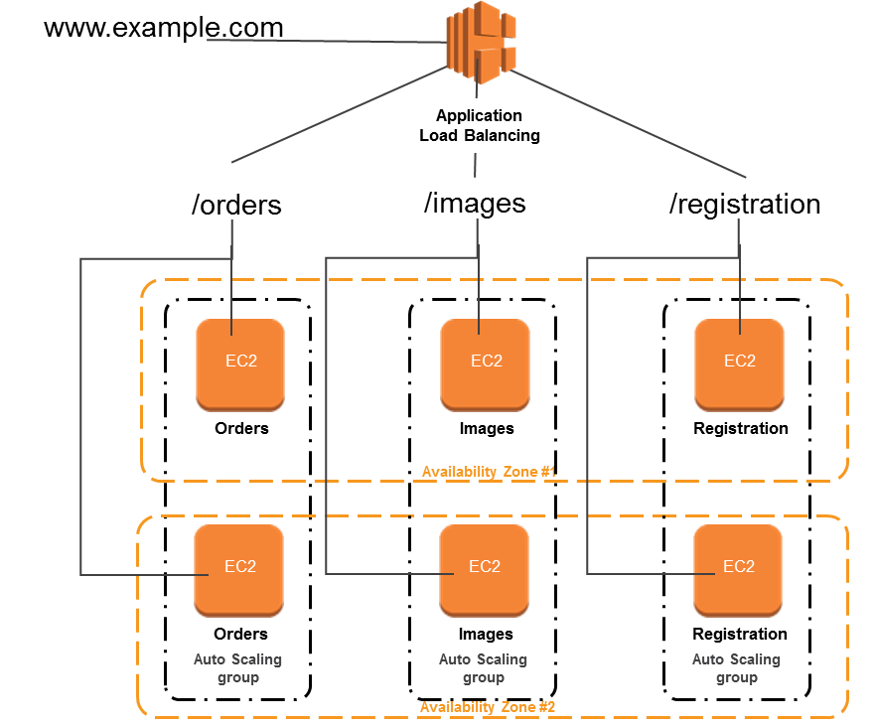
AWS Managed Network Services Application Load Balancer
Application Load Balancers are used to route HTTP/HTTPS (or Layer 7) traffic
Use the concept of rules, targets, and target groups. Rules determine how to route requests.
Host-based or path-based routing rules
Offers SSL offloading. Certificates provided by AWS Certificate Manager and deployed on your load balancer can be renewed automatically.
Notes:
https://aws.amazon.com/blogs/aws/new-advanced-request-routing-for-aws-application-load-balancers/

Slide 46
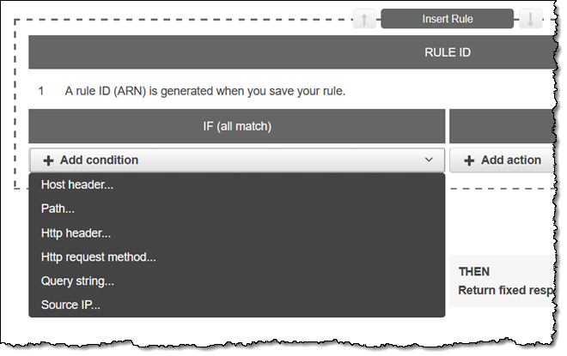
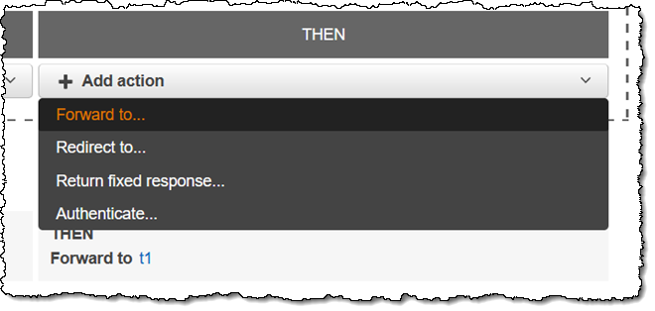
Application Load Balancer rules: if/then

Slide 47
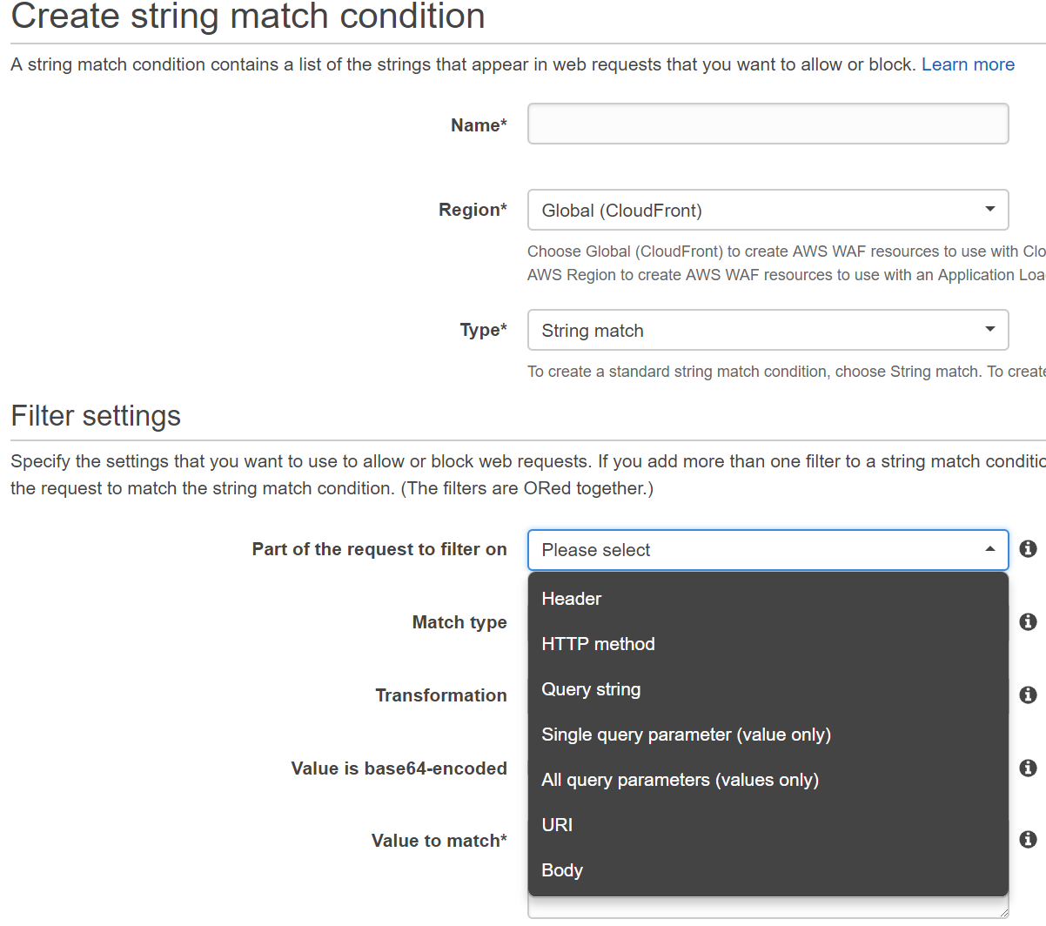
AWS Managed Network Services Web Application Firewall
Uses concepts of Web ACLs based on various conditions, such as IP addresses, Headers
Integrates with Application Load Balancer, API Gateway or CloudFront (AWS CDN)
Rules can be built programmatically

Slide 48
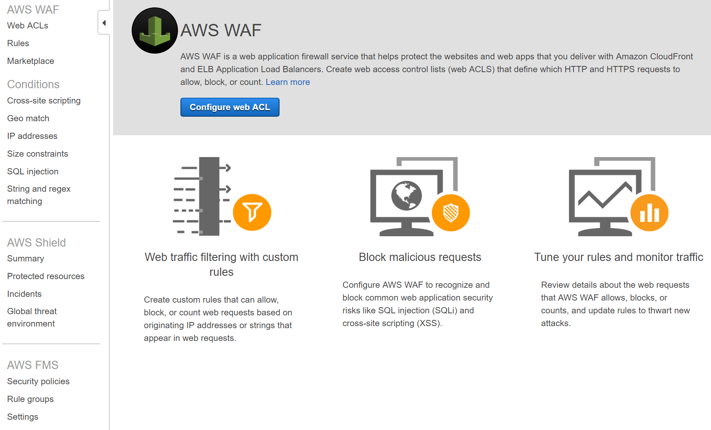
AWS Managed Network Services Web Application Firewall

Slide 49
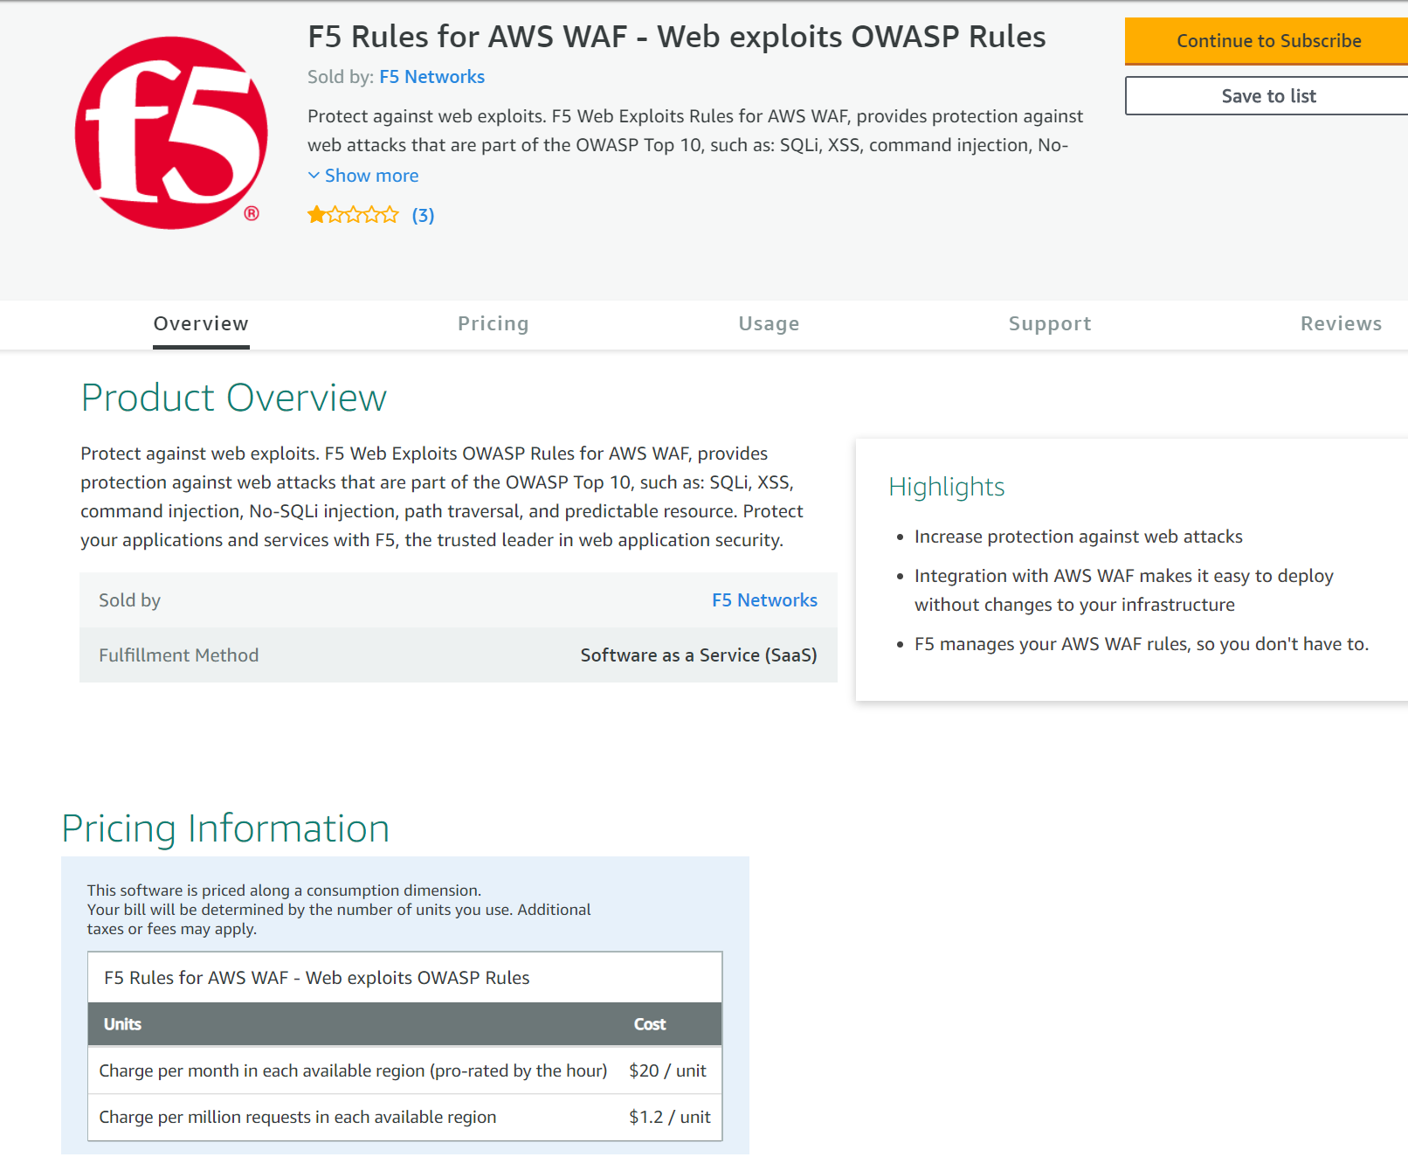
AWS WAF – Managed rules
An option to use third-party managed rules – see AWS Marketplace
See rating and reviews ☺

Slide 50
Putting everything together…..

Slide 51
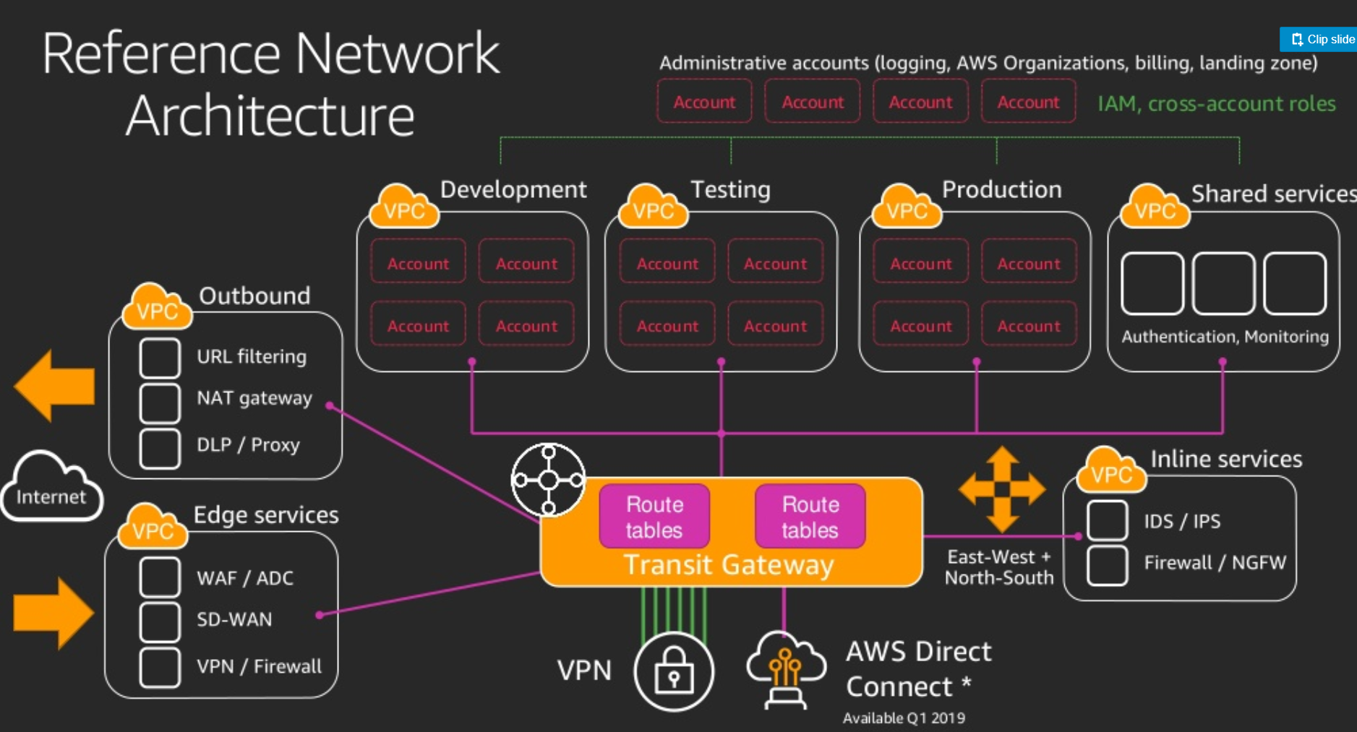
Notes:
Source RE:Invent 2018

Slide 52
And finally….

Slide 53
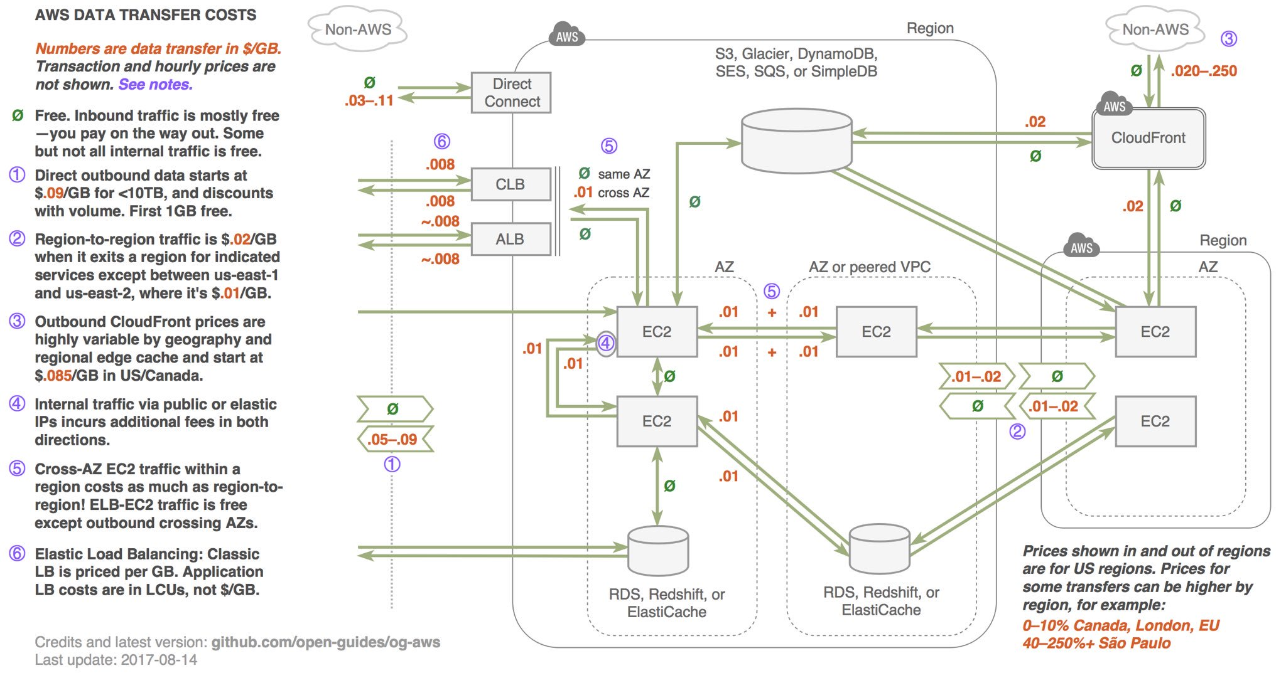

Slide 54
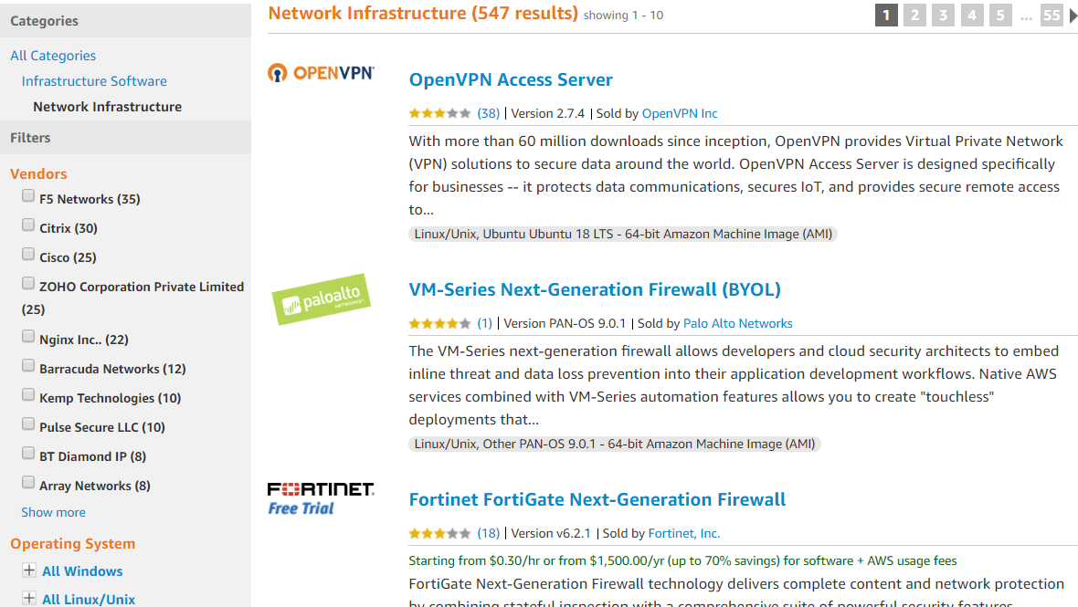
Explore AWS Marketplace

Slide 55
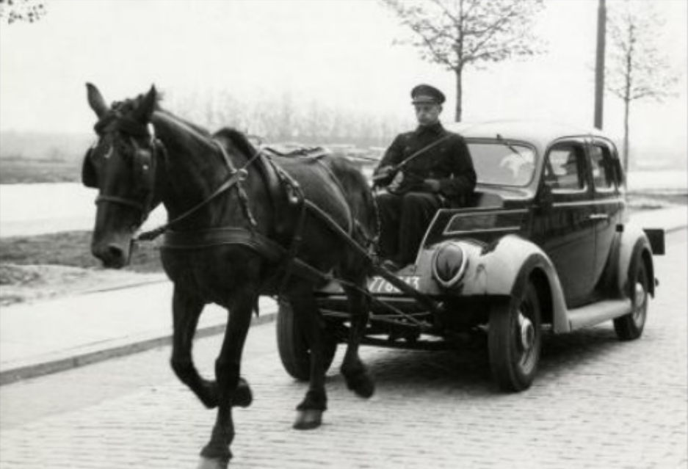
Replicating on-prem networks in the Cloud ?
Learn and use native tools offered by Cloud providers: CloudFormation, CloudWatch, GuardDuty, etc.
Public Cloud Networks are still the same IP networks, yet different

Slide 56
Good read
AWS Certified Advanced Networking Official Study Guide (a bit outdated, but still OK)
https://www.amazon.com/Certified-Advanced-Networking-Official-Study/dp/1119439833
Amazon VPC for On-Premises Network Engineers from Nick Matthews
https://aws.amazon.com/blogs/apn/amazon-vpc-for-on-premises-network-engineers-part-one/
https://aws.amazon.com/blogs/apn/amazon-vpc-for-on-premises-network-engineers-part-two/
https://packetpushers.net/podcast/show-387-aws-networking-view-inside/ - useful links in this podcast!
Re:Invent videos related to networking
For example, from Matt Lehwess ( he’s an Australian ;-) )
Slack:
https://aws-programming-tools.slack.com/
Labs:
https://github.com/awslabs/aws-well-architected-labs

